Slide 1


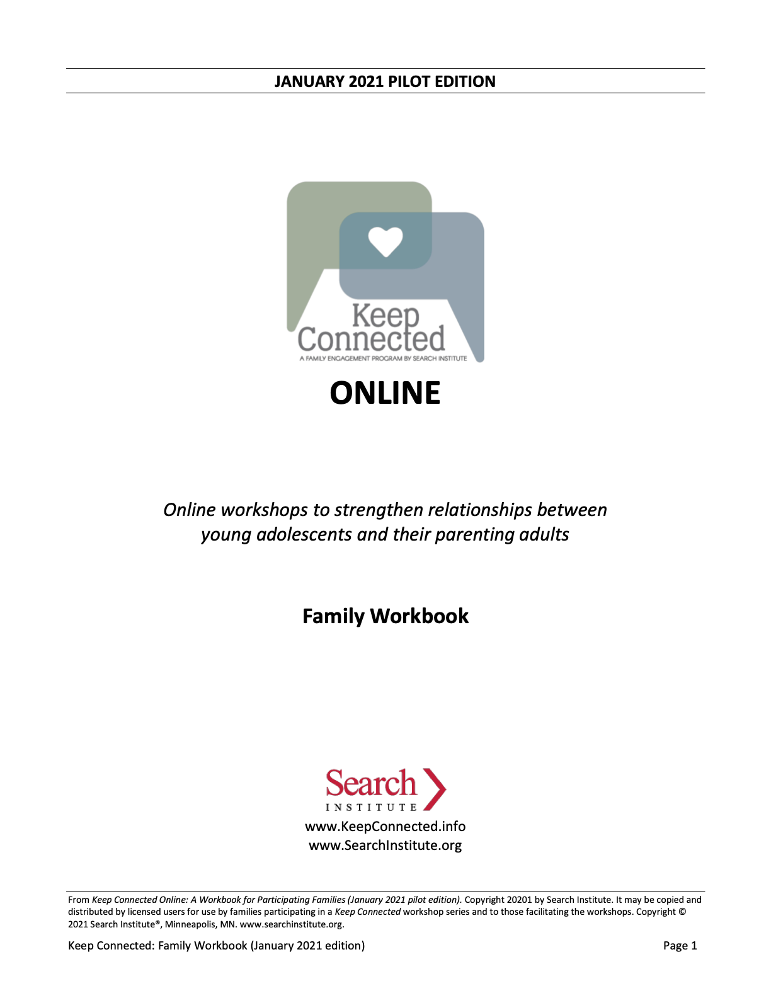
While others are joining us . . .
If you could have any musician come perform at a party for you, who would you invite?
What’s something you’re pretty good at that not a lot of people know about? How did you learn it?
Notes:
HOW TO USE THIS DECK
This deck is designed to be used in conjunction with the Facilitator Guide. It is not adequate on its own.
This deck for Session 1 includes the slides for:
The Parenting Adult Session
The Youth Session
The Family Session
The Extended Parenting Adult Session (if youth are not participating)
If multiple people are facilitating different sessions, you will need multiple copies of the deck.
There is a blank slide between each session.
You may customize the slides to fit your organization and the families you serve. This may include adding your organization’s logo, adjusting words so that they fit with your program’s language, and other adjustments to match the culture and context of your community.
Do not remove Search Institute’s logo or copyright information.
If you add or delete slides, the slide numbers will not match the slides in the facilitator script, so you will need to adjust accordingly.
All photos and art in this deck are copyright free or are used under a Creative Commons license that allows for use with attribution. Do not remove credits for artwork or photographs where it appears.
If you find ways to improve the slides or have trouble with any of them, send your feedback to: gener@searchinstitute.org. We’ll incorporate your feedback into the next version.

Slide 2

Thriving Through the Teenage Years
Session 1: Parenting Adult Session
The Power of Family Relationships

Slide 3

Introductions
Your first name
The names of other people you consider to be part of your family
One thing you enjoy doing together as a family (in just one sentence)
When you’re finished, pick who you want to introduce themselves next.

Slide 4
Features of Keep Connected
Which two are most important to you? Mark them using one of the ANNOTATION marks.
Learn how our family can better communicate and make decisions together | Learn ways young people can do their part to make your family stronger | Discover ways our family can become closer and have fun together
Learn by participating in activities and discussion, not just listening to lectures | Get to know youth and adults from other families | Try things at home based on what we explore during these sessions

Slide 5

Key Ideas for This Session
Young people do best when they have strong relationships with parenting adults through the teen years.
Those relationships change through the teenage years. We need to adapt relationships to keep them strong.
Five key actions help to keep these relationships strong.

Slide 6
Different Perspectives on the Teen Years
Teens . . . | Parenting adults . . .
Are excited to explore and discover new things | Can worry about what kids are curious about
Build relationships with other teens and other adults beyond the family | Wonder if the new relationships make them less important or valued
Want to try new things | Want to protect kids from risks
Sometimes end up in real trouble | Don’t know if or when to intervene. Should kids work it out themselves?
Both perspectives are normal! In most cases, the changes and challenges are normal! Strong, dynamic relationships in families make it easier to deal with the changes and challenges. These sessions focus on nurturing strong relationships through these exciting—and stressful—years!

Slide 7

Make the Most of Family Sessions
Not for you to “teach” your child, but to enjoy learning together. They’ll appreciate it!
Share power: Key for young people learning:
To be responsible
To interact with adults
To find their voice
Adults can dominate. Hold back a bit.
Let youth practice, learn.
Encourage them as they prepare to participate in an adult world.
Families Learning Together

Slide 8

Keep Connected Online is a resource developed by Search Institute, a non-profit organization that partners with schools, youth programs, community coalitions, and other organizations to conduct and apply research that promotes positive youth development and advances equity. Copyright © 2021. It may be used only by facilitators who have been trained by Search Institute. For more information, visit www.KeepConnected.info/family-engagement-programs/

Slide 9
Thriving Through the Teenage Years
Session 1: Youth Session
The Power of Family Relationships

Slide 10
While others are joining us . . .
If you could have any musician come perform at a party for you, who would you invite?
What’s something you’re pretty good at that not a lot of people know about? How did you learn it?
Notes:
HOW TO USE THIS DECK
This deck is designed to be used in conjunction with the Facilitator Guide. It is not adequate on its own.
This deck for Session 1 includes the slides for:
The Parenting Adult Session
The Youth Session
The Family Session
The Extended Parenting Adult Session (if youth are not participating)
If multiple people are facilitating different sessions, you will need multiple copies of the deck.
There is a blank slide between each session.
You may customize the slides to fit your organization and the families you serve. This may include adding your organization’s logo, adjusting words so that they fit with your program’s language, and other adjustments to match the culture and context of your community.
Do not remove Search Institute’s logo or copyright information.
If you add or delete slides, the slide numbers will not match the slides in the facilitator script, so you will need to adjust accordingly.
All photos and art in this deck are copyright free or are used under a Creative Commons license that allows for use with attribution. Do not remove credits for artwork or photographs where it appears.
If you find ways to improve the slides or have trouble with any of them, send your feedback to: gener@searchinstitute.org. We’ll incorporate your feedback into the next version.

Slide 11
Strengths in Your Family
Pick up to 3 statements that fit your family most of the time.
We help each other feel important.
We ask follow-up questions because are really interested.
We help each other learn from mistakes.
We expect each other to use our strengths or gifts.
We help each other solve problems to reach our goals.
We help each other stay focused, follow rules, and get things done.
We plan things together.
When we make decisions, we consider what other people in the family think.
We help each other discover interesting new things.
We help each other imagine different possibilities for our future.

Slide 12
Strengths in Your Family
EXPRESS CARE | We help each other feel important. We ask follow-up questions because are really interested.
CHALLENGE GROWTH | We help each other learn from mistakes. We expect each other to use our strengths or gifts.
PROVIDE SUPPORT | We help each other solve problems to reach our goals. We help each other stay focused, follow rules, and get things done.
SHARE POWER | We plan things together. When we make decisions, we consider what other people in the family think.
EXPAND POSSIBILITIES | We help each other discover interesting new things. We help each other imagine different possibilities for our future.

Slide 13
Make the Most of Family Sessions
  Everyone meets together
  Youth share expectations
  Dig into five keys to strong youth-parent relationships
  Talk about activities to do between sessions
Families Learning Together

Slide 14
Keep Connected Online is a resource developed by Search Institute, a non-profit organization that partners with schools, youth programs, community coalitions, and other organizations to conduct and apply research that promotes positive youth development and advances equity. Copyright © 2021. It may be used only by facilitators who have been trained by Search Institute. For more information, visit www.KeepConnected.info/family-engagement-programs/

Slide 15
Thriving Through the Teenage Years
Session 1: Family Session
The Power of Family Relationships

Slide 16
Family Character Strengths Bingo
Someone in our family has a great sense of humor. | It is important to our family to be generous to others. | We care for each other in our family. | You can count on someone in our family if you need them.
Faith is a big part of our family life. | Our family is able to adapt to many different circumstances. | Our family has a sense of playfulness when we get together. | Honesty is an important value in our family.
We like to give compliments in our family. | Someone in our family works to make the community better for others. | We are forgiving in our family. | Our family comes together when facing a challenge or crisis.
Someone in our family is curious about everything. | Someone in our family expresses deep compassion for those who are suffering. | Our family is hopeful about the future. | We are thankful for what we have in our family.

Slide 17
Group Expectations
COMPLETE THIS SLIDE BASED ON THE YOUTH DISCUSSION TITLED: What Do We Expect from Each Other? You may type in their final list, or you may use the image from the Whiteboard you created. Delete this instruction box.

Slide 18
Relationships in Our Family: Part 1
Examples
In our family, we show each that we matter when we…
Put down the cell phone and ask follow-up questions when they talk about things that are important to them.
On Handout 1.3: Together as a family . . .
Jot ideas of things you do to complete the sentences in each of the boxes. (Don’t worry if you have to skip some.)
When you’ve gone through all the boxes, decide which two or three ideas you’d like share with the whole group.
Decide who will report your ideas to the whole group when it’s your turn.
Some ways we have encouraged each other to keep getting better include . . .
Checking in on Dad’s progress every few days when he set a goal to train to run in a 10K race.
Some ways we treat each other with respect and give each other a say
include . . .
Asking everyone what we should do on a holiday before we make plans.

Slide 19
Relationships in Our Family
When we connect each other with people and places that open up new opportunities or interests, we:
When we show each that we matter, we…
Five Keys to
Strong Youth-Parent Relationships
When we treat each other with respect and give each other a say, we:
When we help each other complete tasks and achieve goals, we:
When we encourage each other to keep getting better, we:

Slide 20
Relationships in Our Families
Session 4
Five Keys to
Strong Youth-Parent Relationships
Session 2
Session 3

Slide 21
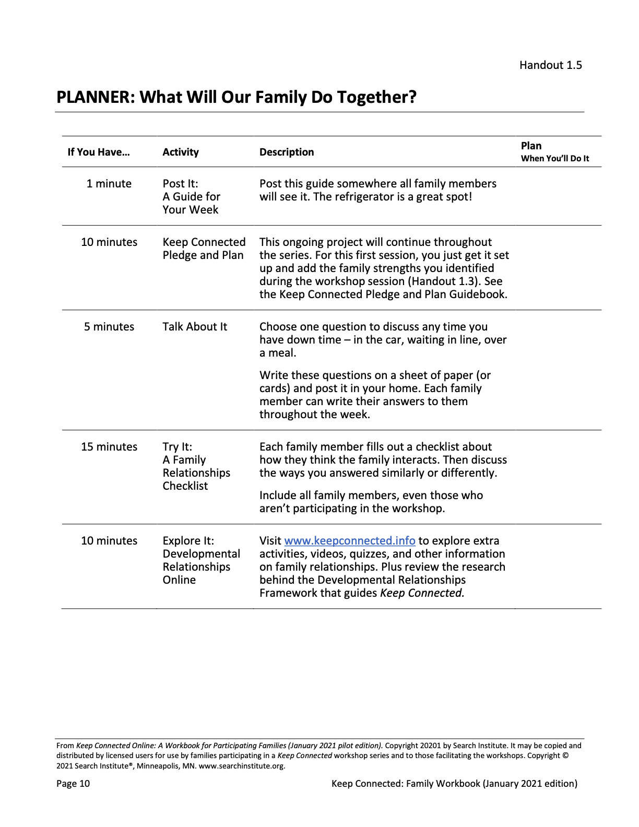
Between the Online Sessions
Follow-Up Conversations and Activities
Post It Key ideas, parenting tips
Talk About It Family discussion starters
Try It Family activities, strategies
Explore It www.KeepConnected.info

Slide 22
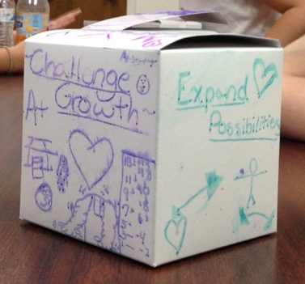
Keep Connected Pledge and Plan: Pledge Box
Each family completes the Pledge Box together after each online session:
Reflect on what was most important to your family from the session.
Focus on how you plan to follow through in small or big ways.
Create shared reminders for your family.
After session 3: Focus on the a couple of priorities that are most important to you to keep your family relationships strong.
During session 4: Share your family’s highlights with us so we can all support you.

Slide 23
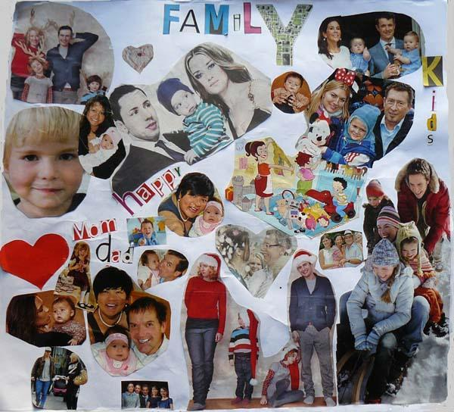
Keep Connected Pledge and Plan: Family Collage
Each family completes the Family Collage together after each online session:
Reflect on what was most important to your family from the session.
Focus on how you plan to follow through in small or big ways.
Create shared reminders for your family.
After session 3: Focus on the a couple of priorities that are most important to you to keep your family relationships strong.
During session 4: Share your family’s highlights with us so we can all support you.

Slide 24
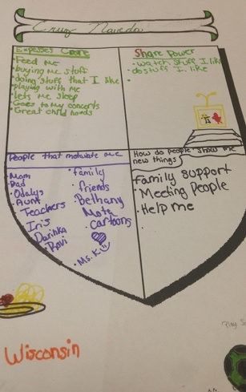
Keep Connected Pledge and Plan: Family Crest
Each family completes the Family Crest together after each online session:
Reflect on what was most important to your family from the session.
Focus on how you plan to follow through in small or big ways.
Create shared reminders for your family.
After session 3: Focus on the a couple of priorities that are most important to you to keep your family relationships strong.
During session 4: Share your family’s highlights with us so we can all support you.

Slide 25

Keep Connected Pledge and Plan: Pledge T-Shirt
Each family completes the Pledge T-Shirt together after each online session:
Reflect on what was most important to your family from the session.
Focus on how you plan to follow through in small or big ways.
Create shared reminders for your family.
After session 3: Focus on the a couple of priorities that are most important to you to keep your family relationships strong.
During session 4: Share your family’s highlights with us so we can all support you.

Slide 26


Wrap-Up: What’s Next
Work on your Keep Connected Pledge and Plan
Reflect on what we’ve explored
What’s most important to your family?
Try discussion starters, quiz, etc.
Next Time: The Power of Caring and Caring About Power, which focuses on two more Keys to healthy parent-child relationships:
Express Care
Share Power
EXPRESS CARE
SHARE POWER

Slide 27
Keep Connected Online is a resource developed by Search Institute, a non-profit organization that partners with schools, youth programs, community coalitions, and other organizations to conduct and apply research that promotes positive youth development and advances equity. Copyright © 2021. It may be used only by facilitators who have been trained by Search Institute. For more information, visit www.KeepConnected.info/family-engagement-programs/

