Slide 1
How to Use This Deck
Customize
If you find ways to improve the slides or have trouble with any of them, send your feedback to: gener@searchinstitute.org. We’ll incorporate your feedback into the next version.

Slide 2


While others are joining us . . .
Complete this sentence: I wish I had a dollar for every time my family . . . .
What was one funny or heartwarming thing that happened in your family since we met last time?

Slide 3


Staying Close While Letting Go
Session 2: Parenting Adult Session
Expressing Care and Sharing Power Change Together Through the Teen Years
EXPRESS CARE
SHARE POWER

Slide 4

Introductions
Your first name
Instead of your last name, the last thing you ate Example: “Sandra Enchilada”
Pick who you want to go next

Slide 5
Our Expectations of Each Other
FILL IN THIS SLIDE BASED ON THE YOUTH EXPECTATIONS FROM SESSION #1

Slide 6
Key Ideas for Session 2
All of us care about each other in our families.
Every family has power dynamics, such as decision making and responsibilities. Each family is different.
As our kids grow up:
Expressing care can become more awkward.
Power issues can turn into power struggles or conflicts.
We can learn practical ways to express care and share power that make them enriching and enjoyable parts of family life.

Slide 7

Highs and Lows
High
A happy or fun experience in your life in the past week.
Each person shares a high and a low
Keep it brief (2-4 sentences)
Share only what you what to share
You may pass if you choose.
Others may respond with a word of support (“congratulations,” “I’m sorry”), but . . .
Don’t interrupt
Don’t ask a lot of questions
Don’t take over with your own story
Don’t give advice or try to “fix” a problem
Low
A sad or hard experience in your life in the past week.

Slide 8

“Show me that I matter to you”
NOT ALL THE SAME: Expressing care looks different in every family. We each do it different ways.
VALUABLE: Caring parent-youth relationships help:
Deepen bonds with each other
Form relationships with other people
Reduce stress
Feel more confident
Be dependable
Listen
Believe in me
Be warm
Encourage
TWO-WAY
Parenting adults express care to young people
Young people express care to parenting adults (and its our job to help them learn)

Slide 9
Showing Affection with Teenagers
Ask them what they want, and adjust.
Respect boundaries and privacy.
Spend time together (not just on chores).
Do physical things together.
Keep smiling, joking, and laughing together.
Try not to take it too personally.

Slide 10



Five Keys to Youth—Parent Relationships
EXPRESS CARE
CHALLENGE GROWTH
PROVIDE SUPPORT
SHARE POWER
EXPAND POSSIBILITIES

Slide 11
Power Struggles: Questions to Ask Yourself
1. What will help you slow down and cool down?
2. What’s behind the power struggle?
3. Are they right this time?
4. What’s the best way to share power in this instance?
5. Do you need to stay firm this time?
6. When can you say yes?
7. How will you keep expressing care?
8. What’s the big picture?

Slide 12
“Treat me with respect and give me a say”
How Sharing Power Helps . . .
Parents
Deepens their relationships with kids
Learn to trust kids
Young People
Become more responsible, motivated
Adjust to school transitions
Negotiate and solve problems
Avoid risky behaviors; make better decisions
Helps prepare for relationships throughout life
Respect me
Include me
Collaborate
Let me lead

Slide 13
Share Power to Nurture Responsibility
Explain decisions, rather than just saying, “Because I said so.”
Pay attention to young person’s feelings, opinions, and perspectives.
Give choices to pick from.
Encourage young people to take the lead where they are ready.
Through These Actions
Show RESPECT to each other.
INCLUDE all people who will affected in the decision.
WORK TOGETHER to solve problems and reach goals.
Let EACH PERSON LEAD.

Slide 14

Transition to the Family Session
Families Learning Together

Slide 15

Keep Connected Online is a resource developed by Search Institute, a non-profit organization that partners with schools, youth programs, community coalitions, and other organizations to conduct and apply research that promotes positive youth development and advances equity. Copyright © 2021. It may be used only by facilitators who have been trained by Search Institute. For more information, visit www.KeepConnected.info/family-engagement-programs/

Slide 16
While others are joining us . . .
Complete this sentence: I wish I had a dollar for every time my family . . . .
What was one funny or heartwarming thing that happened in your family since we met last time?

Slide 17
Staying Close While Letting Go
Session 2: Youth Session
Expressing Care and Sharing Power Change Together Through the Teen Years
EXPRESS CARE
SHARE POWER

Slide 18
Introductions
Your first name
Instead of your last name, the last thing you ate Example: “Sandra Enchilada”
Pick who you want to go next

Slide 19
Our Expectations of Each Other
FILL IN THIS SLIDE BASED ON THE YOUTH EXPECTATIONS FROM SESSION #1

Slide 20
Highs and Lows
High
A happy or fun experience in your life in the past week.
Each person shares a high and a low
Keep it brief (2-4 sentences)
Share only what you what to share
You may pass if you choose.
Others may respond with a word of support (“congratulations,” “I’m sorry”), but . . .
Don’t interrupt
Don’t ask a lot of questions
Don’t take over with your own story
Don’t give advice or try to “fix” a problem
Low
A sad or hard experience in your life in the past week.

Slide 21
We express care when we show other people that they matter to us
Some ways we express care are by:
Being dependable for each other—keeping our promises
Listening to each other
Believing in each other
Being warm and friendly
Encouraging each other

Slide 22
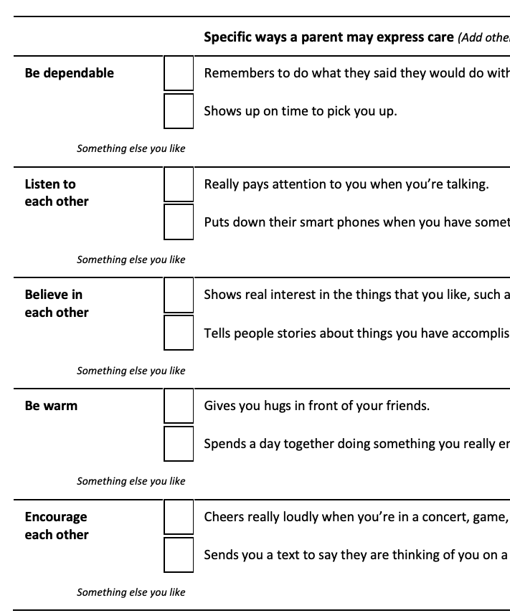
Instructions: More, Less, or Not at All?
On Handout 2.5 in your Family Workbook
Write one of the symbols in each box based on how much you would like your parents to express care in this way.
In each row labeled “something else you like,” write one other way you like your parent(s) to show you that they care that relates to that area (if you can think of something).
More Less
Same Not at all
4. Would most appreciate more

Slide 23
Five Keys to Youth—Parent Relationships
EXPRESS CARE
CHALLENGE GROWTH
PROVIDE SUPPORT
SHARE POWER
EXPAND POSSIBILITIES

Slide 24
Four Actions that Share Power
Show RESPECT to each other.
INCLUDE all people who will affected by a decision in making that decision.
WORK TOGETHER to solve problems and reach goals.
Let EACH PERSON LEAD and make decisions.

Slide 25
Transition to the Family Session
Families Learning Together

Slide 26
Keep Connected Online is a resource developed by Search Institute, a non-profit organization that partners with schools, youth programs, community coalitions, and other organizations to conduct and apply research that promotes positive youth development and advances equity. Copyright © 2021. It may be used only by facilitators who have been trained by Search Institute. For more information, visit www.KeepConnected.info/family-engagement-programs/

Slide 27
Staying Close While Letting Go
Session 2: Family Session
All of us care about each other in our families. Every family deals with power dynamics, though each family is different.
Both expressing care and sharing power can become more challenging or awkward as kids grow up.
There are practical ways to express care and share power that make them enriching and enjoyable parts of family life.
EXPRESS CARE
SHARE POWER

Slide 28

How Does Your Family Recharge?
1. Your family name(s)k
2. One way your family “recharges” when you are tired and need to “get your power back"

Slide 29
Common Power Struggles in Our Families
Most common power struggles in families (based on perspectives from those in your youth and parent sessions):
Parenting Adult Perspectives | Youth Perspectives
NOT READY TO USE YET
ADD THE TOP 3-5 POWER STRUGGLES THAT WERE IDENTIFIED SEPARATELY IN THE PARENTING ADULT AND YOUTH POLLS FROM THEIR SESSIONS. JUST LIST THE POWER STRUGGLE AREAS, NOT THE PERCENTAGES DUE TO LOW SAMPLE SIZES.
Through These Actions
Show RESPECT to each other.
INCLUDE all people who will affected in the decision.
WORK TOGETHER to solve problems and reach goals.
Let EACH PERSON LEAD.

Slide 30
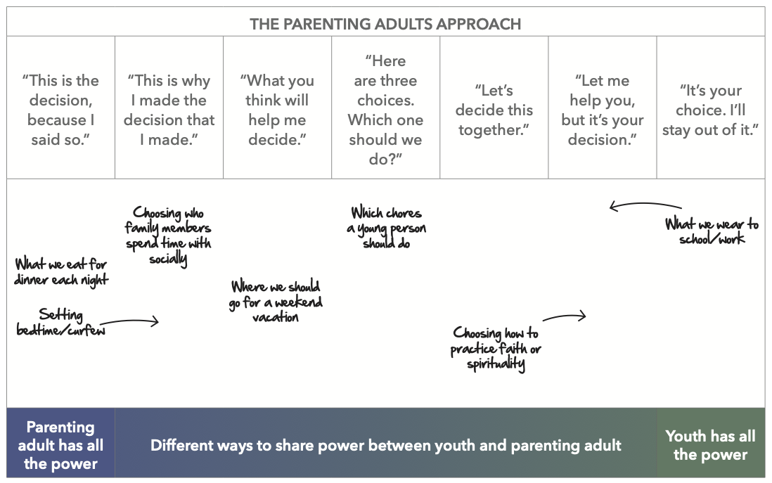
Power Sharing: What Fits Your Family?
Through These Actions
Show RESPECT to each other.
INCLUDE all people who will affected in the decision.
WORK TOGETHER to solve problems and reach goals.
Let EACH PERSON LEAD.

Slide 31
How We’ve Expressed Care
 | How Parenting Adults Have Expressed Care | How Young People Have Expressed Care
Be dependable—Be someone I can trust.
Listen—Really pay attention when we are together.
Believe in me—Make me feel known and valued.
Be warm—Show me you enjoy being with me.
Encourage me—Praise me for my efforts and achievements.
How have you seen or felt others Express Care during this session?
Call it out or send it in the chat.
It can be someone in your family or someone in another family. Be specific!

Slide 32




Check In on Last Session’s Follow-Up Activities
 |  |  |  | www.keepconnected.info
A Guide for Your Week | Keep Connected Pledge and Plan | Discussion Starters | A Family Relationships Checklist | Explore Online
EACH FAMILY: Put an ANNOTATION mark in bottom box for activities you completed since the last session.

Slide 33
Planning Activities to Follow Up from This Session
 |  |  |  | www.keepconnected.info
A Guide for Your Week | Keep Connected Pledge and Plan Express Care Share Power | Discussion Starters | Highs & Lows Yes, And . . . Expressing Care During Shared Family Meals Practicing Negotiating Together | Explore Online

Slide 34
Next Time
In the Zone: Challenge and Support Growth
CHALLENGE GROWTH
PROVIDE SUPPORT
Add information about your next session here.
Or delete this box.

Slide 35
Keep Connected Online is a resource developed by Search Institute, a non-profit organization that partners with schools, youth programs, community coalitions, and other organizations to conduct and apply research that promotes positive youth development and advances equity. Copyright © 2021. It may be used only by facilitators who have been trained by Search Institute. For more information, visit www.KeepConnected.info/family-engagement-programs/

