Slide 1
How to Use This Deck
Customize
If you find ways to improve the slides or have trouble with any of them, send your feedback to: gener@searchinstitute.org. We’ll incorporate your feedback into the next version.

Slide 2


While others are joining us . . .
What is one idea, concept, perspective, or experience has really changed the way you look at life or at the world? (It might be a book you read, a place you visited, a new discovery, etc.)
Who are one or two people in your community who you would like to meet? What would you want to talk with them about?
What is something you hope you can see or do in the next 10 years that you’ve never been able to do before?

Slide 3

New Possibilities for Our Family and the Future
Session 4: Parenting Adults

Slide 4

Introductions
Your first name . . . AND
Something you’ve tried in the past month for the first time. E.g.:
An activity
A game
A place you’ve visited
A food
An idea
Pick who you want to go next

Slide 5

Backward and Forward (instead of Highs and Lows)
Each person shares a high and a low
Keep it brief (2-4 sentences)
Share only what you what to share
You may pass if you choose.
Others may respond with a word of support (“congratulations,” “I’m sorry”), but . . .
Don’t interrupt
Don’t ask a lot of questions
Don’t take over with your own story
Backward
Something you’ve learned or enjoyed about these sessions, including what you’ve done just with your family.
Forward
Something you plan to keep doing with your family as a result of this experience.

Slide 6
Expand Possibilities: Key Ideas
Expanding possibilities keeps our minds fresh and growing.
By connecting young people with new people, places, and experiences, parents open doors for their children to:
Discover more about themselves and what matters.
Find new opportunities.
Play meaningful, responsible roles in society.
Connect with people who look out for them.
Teen relationships with their parents usually improve when teens also form relationships with other trustworthy adults.
When kids are exposed to other ideas, they learn and grow—particularly when they talk about those ideas at home.

Slide 7
Expand Possibilities
INSPIRE kids to see new possibilities for the future
CONNECT kids with people who can help them grow
EXPOSE kids to new ideas, experiences, and places that broaden their horizons

Slide 8




EXPRESS CARE
CHALLENGE GROWTH
PROVIDE SUPPORT
SHARE POWER
EXPAND POSSIBILITIES

Slide 9
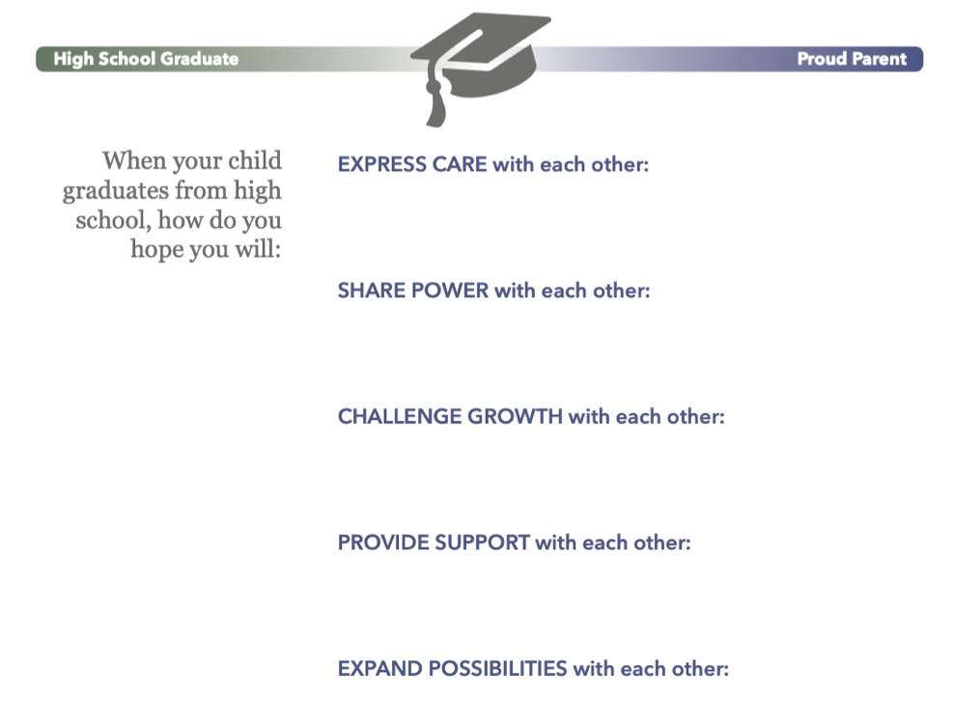
Your Relationship When It’s Time to Graduate

Slide 10
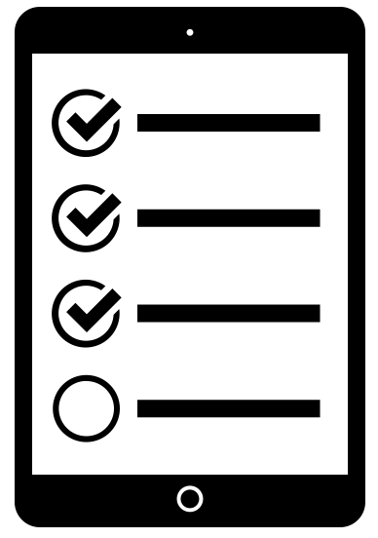
Survey for PARENTS: Your Honest Back
Feedback to improve future workshops.
Voluntary and anonymous. We appreciate your honest feedback.
You may skip questions if you choose.
It takes less than 10 minutes for most people.
We will share results with everyone who participated.
Created by Thomas Marijinssen from Noun Project

Slide 11

Transition to the Family Session
Families Learning Together

Slide 12

Keep Connected Online is a resource developed by Search Institute, a non-profit organization that partners with schools, youth programs, community coalitions, and other organizations to conduct and apply research that promotes positive youth development and advances equity. Copyright © 2021. It may be used only by facilitators who have been trained by Search Institute. For more information, visit www.KeepConnected.info/family-engagement-programs/

Slide 13
While others are joining us . . .
What is one of the biggest goals that you or someone else in your extended family (now or in the past) has worked hard to meet? How did others support them?
If you could enter and win a competition, what competition would it be? (It doesn’t have to be realistic!) What would you most enjoy about it?

Slide 14
New Possibilities for Our Family and the Future
Session 4: Youth

Slide 15
Introductions
Your first name . . . AND
Something you’ve tried in the past month for the first time. E.g.:
An activity
A game
A place you’ve visited
A food
An idea
Pick who you want to go next

Slide 16
Backward and Forward (instead of Highs and Lows)
Each person shares a high and a low
Keep it brief (2-4 sentences)
Share only what you what to share
You may pass if you choose.
Others may respond with a word of support (“congratulations,” “I’m sorry”), but . . .
Don’t interrupt
Don’t ask a lot of questions
Don’t take over with your own story
Backward
Something you’ve learned or enjoyed about these sessions, including what you’ve done just with your family.
Forward
Something you plan to keep doing with your family as a result of this experience.

Slide 17
EXPRESS CARE
CHALLENGE GROWTH
PROVIDE SUPPORT
SHARE POWER
EXPAND POSSIBILITIES

Slide 18
Survey for YOUTH: Your Honest Back
Feedback to improve future workshops.
Voluntary and anonymous. We appreciate your honest feedback.
You may skip questions if you choose.
It takes less than 10 minutes for most people.
We will share results with everyone who participated.
Created by Thomas Marijinssen from Noun Project

Slide 19
Transition to the Family Session
Families Learning Together

Slide 20
Keep Connected Online is a resource developed by Search Institute, a non-profit organization that partners with schools, youth programs, community coalitions, and other organizations to conduct and apply research that promotes positive youth development and advances equity. Copyright © 2021. It may be used only by facilitators who have been trained by Search Institute. For more information, visit www.KeepConnected.info/family-engagement-programs/

Slide 21
New Possibilities for Our Family and the Future
Session 4: Families

Slide 22
Parenting Adults’ Hopes
SLIDE 22: ADD STATEMENTS FROM PARENTING ADULTS FROM ACTIVITY #5 IN THE PARENTING ADULT SECTION: “LOOKING FORWARD: EXPANDING POSSIBILITIES BETWEEN NOW AND HIGH SCHOOL GRADUATION.

Slide 23
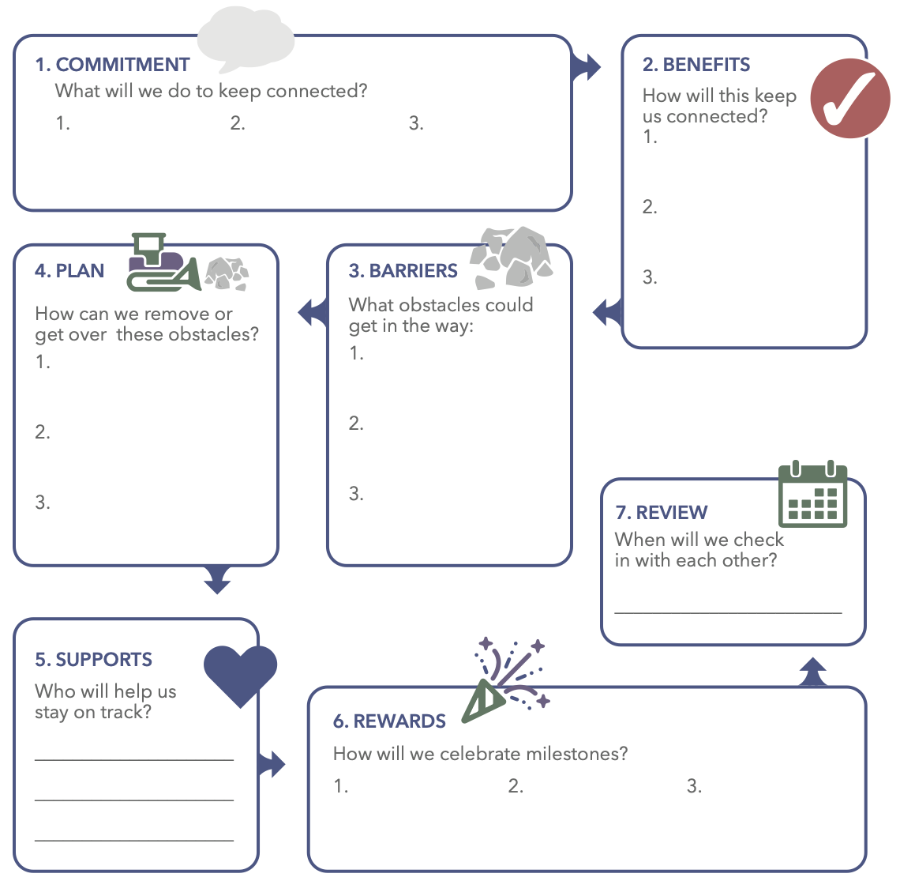
Good Habits to Keep Connected

Slide 24
A Pledge to Keep Connected
We will . . .
Express care, so we never forget that we matter to each other.
Challenge growth, encouraging each other to keep getting better to reach our goals.
Provide support, helping each other overcome barriers to get things done.
Share power, because all of us need respect, voice, and meaningful roles.
And expand possibilities, inviting us all to a brighter future.

Slide 25
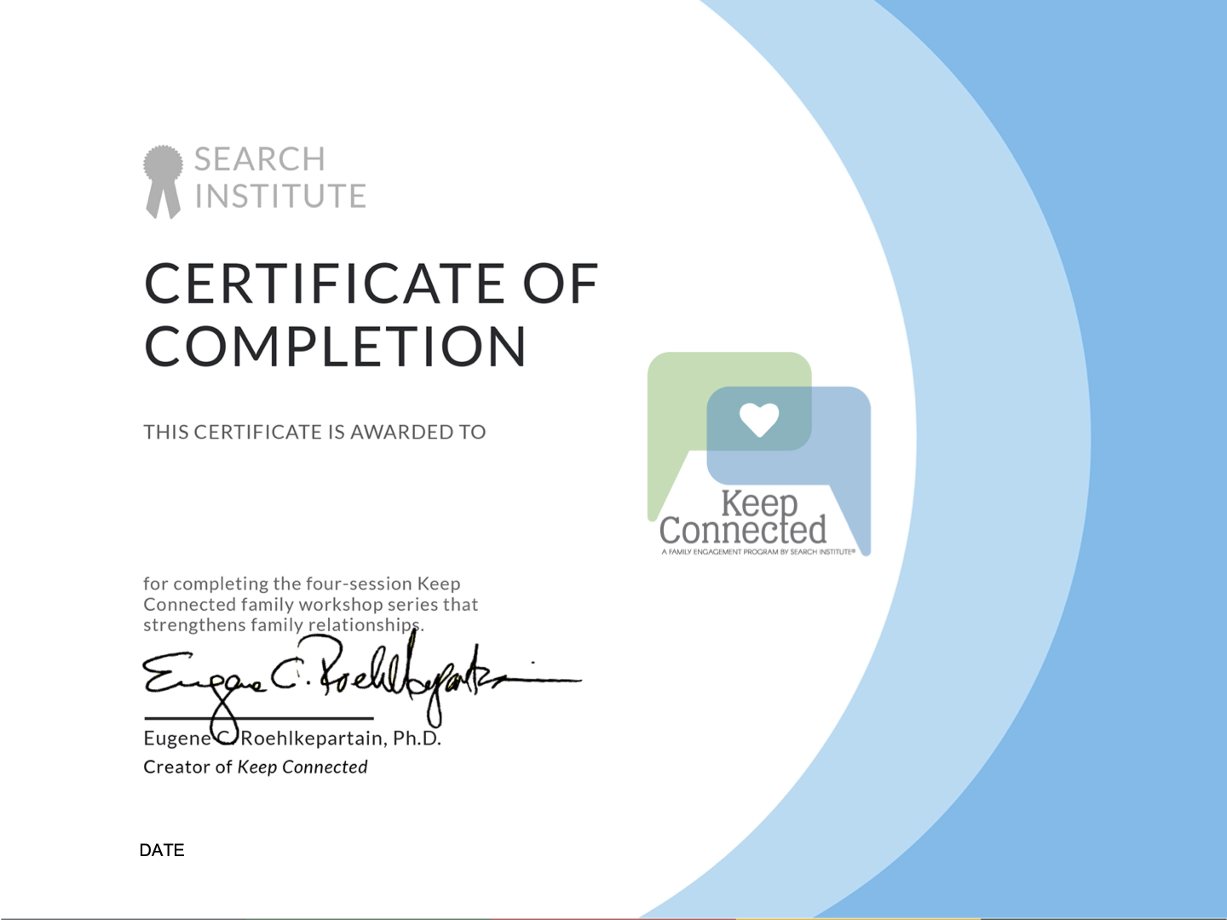

Slide 26
Keep Connected Online is a resource developed by Search Institute, a non-profit organization that partners with schools, youth programs, community coalitions, and other organizations to conduct and apply research that promotes positive youth development and advances equity. Copyright © 2021. It may be used only by facilitators who have been trained by Search Institute. For more information, visit www.KeepConnected.info/family-engagement-programs/

